Slide 1
John 14:1-14
How to Turn Confusion into Comfort
Dr. Rick Griffith, Poulsbo Community Church, Poulsbo, WA PoulsboCC.com & BibleStudyDownloads.org

Slide 2
Separation
Notes:
One reality that we all face in life is separation from those we love.

Slide 3
Many Separations
Notes:
My wife Susan and I have served the Lord in Singapore for 26 years. This has included saying an average of one “goodbye” each year, as we have had about 26 round trips across the Pacific.

Slide 4
The Griffiths 9 Jan 2016
2017
Stephen & Katie (28)
John (25)
Kurt & Cara (30)
Susan & Rick
Notes:
This initially meant we bade farewell to our parents and siblings. Now that our three sons and their wives live in the USA while we continue to serve among the nations in Singapore, these goodbyes are with our sons as well as parents

Slide 5
SBC Courses I Teach
Survey • The Bible…Basically
OT NT Bible Study
Backgrounds • Research & Writing
OT NT Geography
Theology • Creation • Jesus
Church • Spirit • Salvation • Future
Preaching
Homiletics 1 Homiletics 2
Notes:
I have taught Bible survey, backgrounds, theology and preaching…

Slide 6
SINGAPORE BIBLE COLLEGE
9
Notes:
…at Singapore Bible College over the years

Slide 7
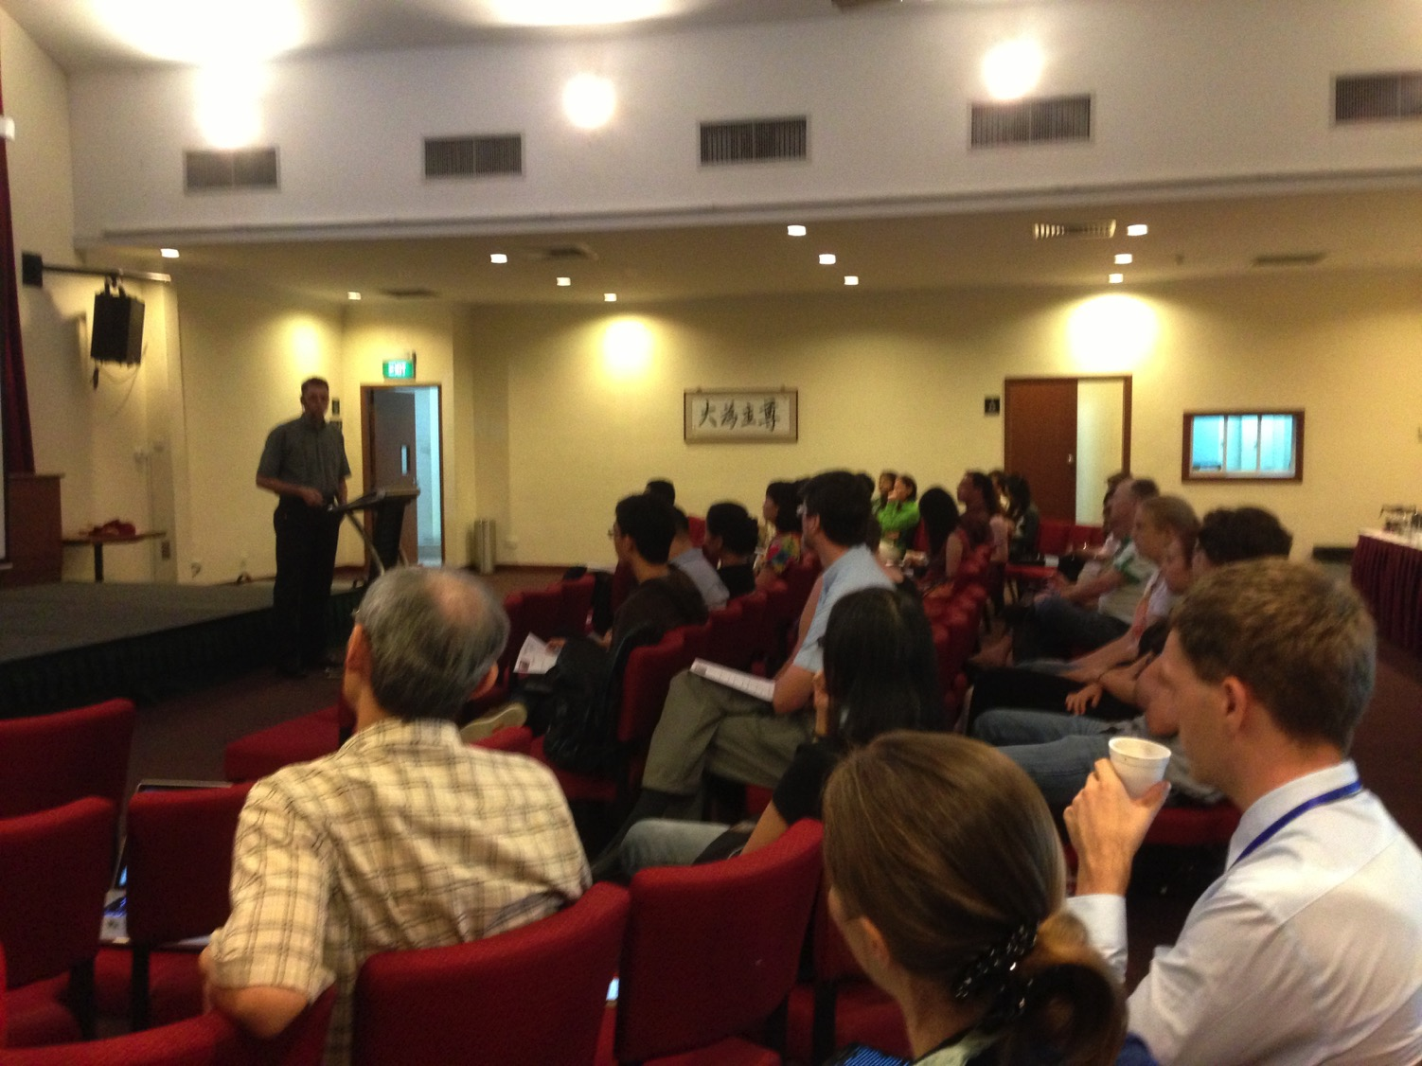
Our People
9
37 people from 10 nations
November 2017
Notes:
…as well as pastoring Crossroads International Church…

Slide 8
Teaching Ministry 1997-2017
MONGOLIA
JORDAN
KOREA
CHINA
NEPAL
MYANMAR
INDIA
THAILAND
VIETNAM
MALAYSIA
SRI LANKA
SINGAPORE
INDONESIA
SBC
Notes:
…and ministry across 12 other countries in Asia where I train pastors.

Slide 9
Confusion
Notes:
This involves many “hellos” and “goodbyes” which can bring confusion and discouragement.

Slide 10
Relational Disappointment
Notes:
For some of us, family is often the CAUSE of confusion rather than the cure. Our expectations might be too high, our family relationships still unresolved, or whatever. We feel confused and discouraged.

Slide 11
Are you disappointed?
confused?
discouraged?
Notes:
In any event, are you confused or discouraged today?
Maybe it has nothing to do with separations from loved ones. Maybe you are disappointed with missed opportunities or with what’s happening at work—not feeling understood, working too many hours, not getting paid decently, or bad decisions where you pay a heavy price.

Slide 12
Disappointment with God
Notes:
For some of us, discouragement comes when we have prayed and prayed but our prayers don’t seem to go higher than the ceiling.

Slide 13
Confusion
Notes:
At other times, we’re confused or discouraged and we don’t even know why!

Slide 14
Disappointment
Notes:
In any case, we just know that we need God to fill the void. Wouldn’t it be great to just exchange our confusion and disappointment with Christ’s comfort?

Slide 15
Confusion
Comfort
Notes:
But how do you do that? How can you replace your confusion with Christ’s comfort?

Slide 16
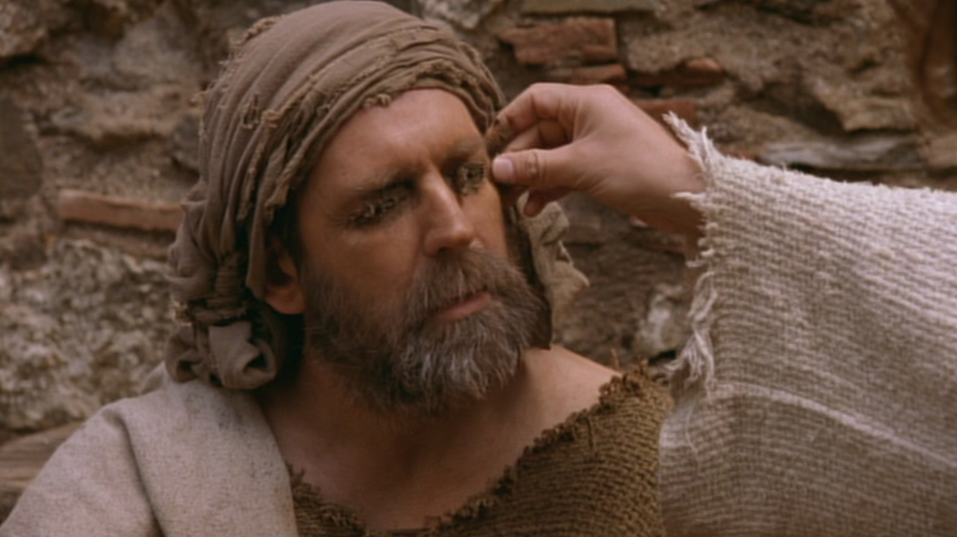
Jesus proved He was the way for eternal life by miraculously healing a blind man (John 9)
Notes:
In John 1–13 the disciples had seen Jesus do incredible things—
They saw him heal the blind…

Slide 17
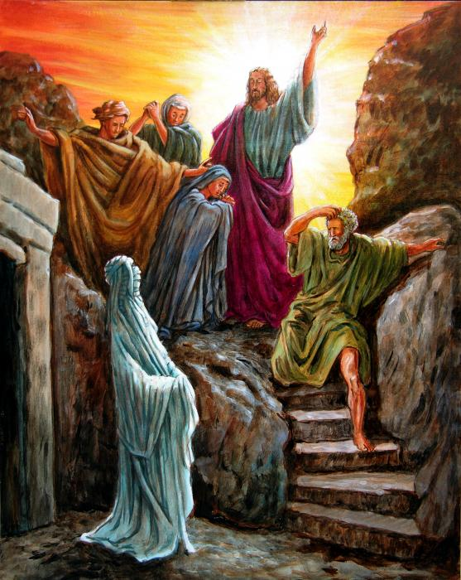
“Lazarus, come out!” (John 11)
Notes:
…and raise the dead as the climax of seven signs—so they placed their trust in him.

Slide 18
Signs in John's Gospel
Signs unique to John's Gospel in yellow (6 of the 9 miracles)
WATER TO WINE 2:1-11
HEALING OFFICIAL'S
SON 4:46-54
HEALING PARALYTIC 5:1-18
FEEDING 5000 6:1-15
WALKING ON WATER 6:16-24
HEALING BLIND MAN 9:1-7
RAISING LAZARUS 11:1-45
CHRIST'S RESURRECTION 20:1-31
FISH CATCH 21:1-3
Notes:
After John 14, two more signs still lay ahead.

Slide 19
John
Notes:
But what was the point of all these signs? I used to sum up the Gospel of John with the word “belief” until one day it hit me that the noun “belief” never even appeared in the gospel! In this book the noun “belief” never appears…

Slide 20
Believe—Not Belief
In this book the noun “belief” never appears, but the verb forms to “believe” appear 87 times and in nearly every chapter!

Slide 21
So Believe
Notes:
Thus Lincoln calls this series appropriately “So Believe.”

Slide 22
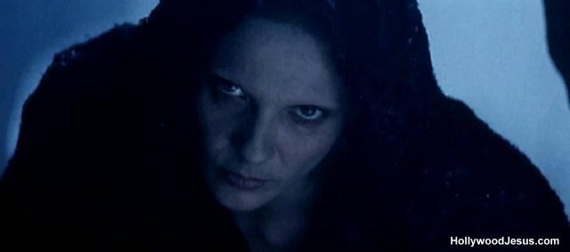
Judas had left to betray Christ
"As soon as Judas took the bread, Satan entered into him" (13:27)
Notes:
But in chapter 13 in the Upper Room Jesus had just told them that Judas would betray him (13:21)

Slide 23
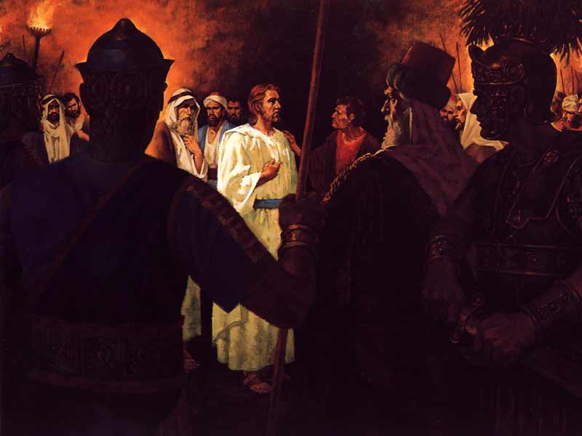
Jesus predicted that Peter would deny him that very night (13:38)
Notes:
Peter would deny him (13:38)…

Slide 24
Separation
Notes:
…and that he was going away where they couldn’t follow (13:33). They were confused and discouraged!

Slide 25
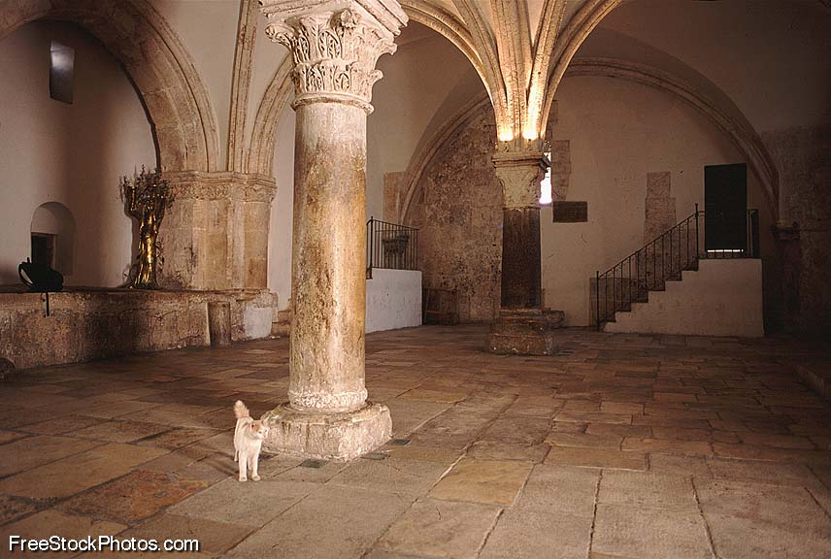
Preparing the Disciples in the Upper Room Discourse (John 13:31–16:33)
Notes:
John 14 records how Jesus comforted them in their confusion and discouragement. They were at the Passover meal in the Upper Room—

Slide 26
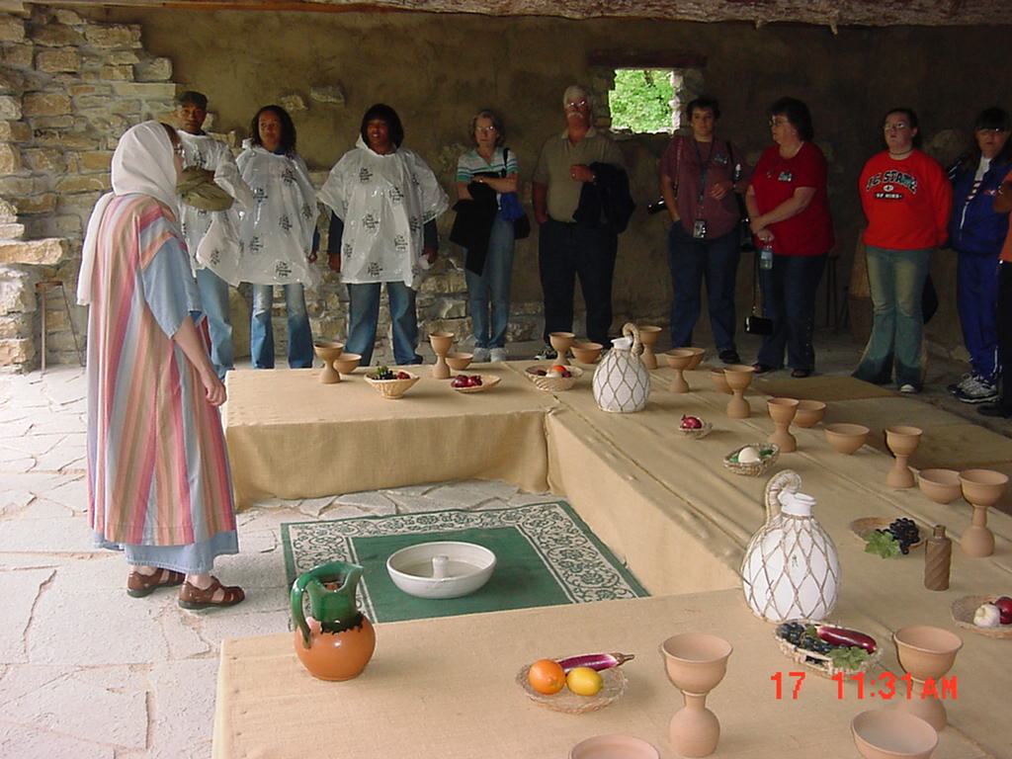
Both Jews and Romans reclined at a “U”-shaped table
Notes:
—all seated around a “U-shaped” table—dumbfounded with confusion.

Slide 27
Subject
How can you replace your confusion with Christ’s comfort?
Notes:
They needed to exchange their confusion with Christ's comfort, even as you and I need to do also.

Slide 28
Confusion
2 ways to replace confusion with comfort
Comfort
Notes:
Today we’ll see that Jesus gives two ways to replace confusion with comfort during times of discouragement. The first way to turn confusion into comfort is to…

Slide 29
MPI
John 14:1-14: Jesus shows how to gain comfort
Trust Jesus to return for you (14:1-4).
Notes:
Believe that Christ will come back to bring you to your heavenly home.

Slide 30
“Don't let your hearts be troubled. Trust in God, and trust also in me” (John 14:1 NLT)

Slide 31
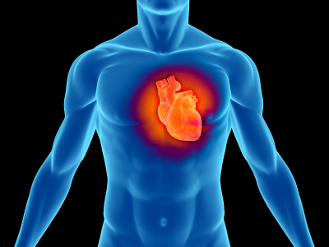
Your Heart
“Trust in the Lord with all your heart; do not depend on your own understanding” (Prov. 3:5)
“Guard your heart above all else, for it determines the course of your life” (Prov. 4:23)
Notes:
Your heart is the center of your personality. You are responsible for the condition of your own heart…

Slide 32
“Don't let your hearts be troubled. Trust in God, and trust also in me” (John 14:1 NLT)
Notes:
Christ gives three commands here—one on what not to do (“don’t be troubled”) and two on whom to trust—trust both the Father and the Son. But how do you trust God and Jesus? Well…

Slide 33
John 14:2 Mansions (KJV)
“In my Father's house are many mansions...” (KJV)
Notes:
Know that Jesus is preparing heaven until he brings you home at the Rapture (14:2-3).
The KJV says Jesus is preparing “mansions” in the Father’s house, which doesn’t make sense now.

Slide 34
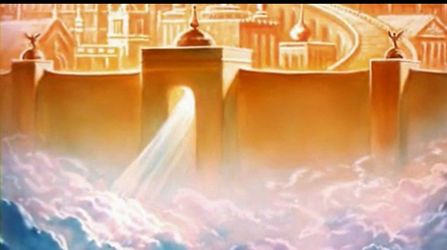
John 14:2 ESV
"In my Father’s house are many rooms. If it were not so, would I have told you that I go to prepare a place for you?"
Notes:
A “mansion” simply meant a “dwelling place” then.
Some say studying what the Bible says about the future is only academic and useless.
Jesus disagrees. He could have sought to comfort his men in any number of ways during this difficult time, but he decided to tell them about his return.

Slide 35
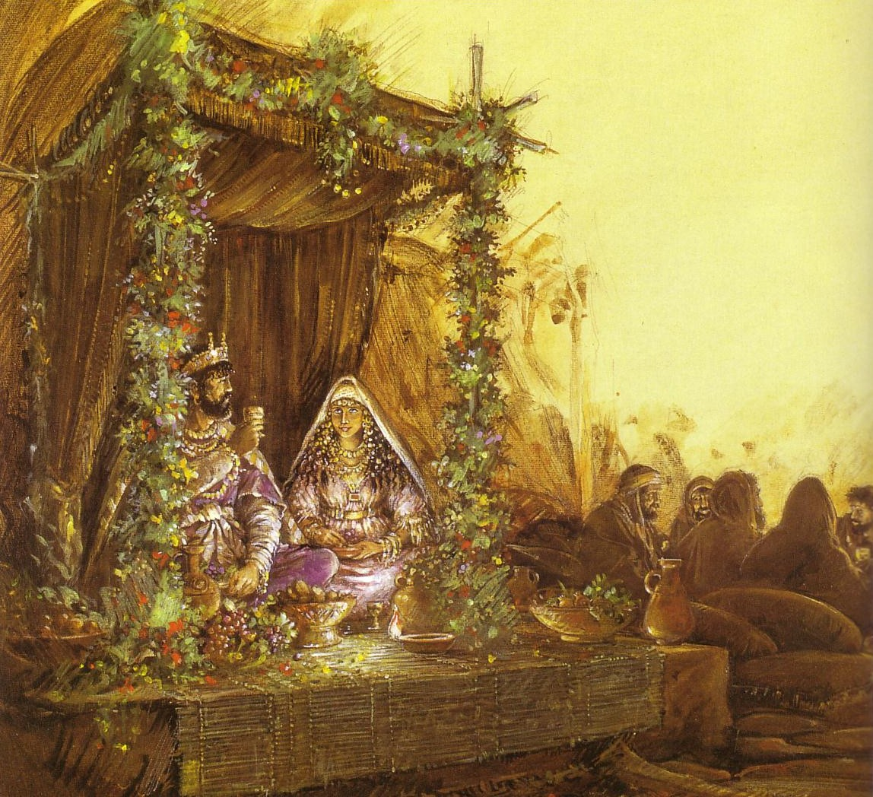
Marriage Backgrounds in Jewish Literature
Marriage depicts Christ's love for the church (Eph. 5)
Notes:
The imagery here is wonderful as in the NT, marriage often depicts Christ’s love for the church.

Slide 36
The First Century Wedding Procession
Groom's House (in Father's House)
The procession parallels Christ's return for His Bride, the Church
Bride's House
Notes:
In first century Jewish life, the groom would prepare for his wedding by building an addition onto his father’s house during the yearlong betrothal period. Then, when it was ready, he would leave his father’s home, travel to the bride’s house and bring her back to his father’s home!

Slide 37
“We will be caught up (“raptured”) in the clouds to meet the Lord in the air” (1 Thess. 4:17)
Notes:
Here is the first time Jesus mentioned this truth to the disciples—that he would leave to prepare heaven for us as his bride, but then return to bring us back to be with him in the Father’s house! In 1 Thess. 4:17 this is called the “catching up,” or “Rapture”!

Slide 38
John 14:4 NLT/ESV
"And you know the way to where I am going" (John 14:4)

Slide 39
MPI
John 14:1-14: Jesus shows how to gain comfort
Trust Jesus to return for you (14:1-4).
Notes:
Believe that Christ will come back to bring you to your heavenly home.
What a comfort to the troubled disciples—and to us! When I am confused, God is telling me to replace that confusion with the comfort that Jesus will return for me! But Jesus went on to comfort them in a second way where he said to…

Slide 40
MPII
John 14:1-14: Jesus shows how to gain comfort
Trust Jesus to bring you to God (14:5-14).
Notes:
Believe that Jesus alone can get you to heaven.
Let's read verses 5-7… [read]

Slide 41
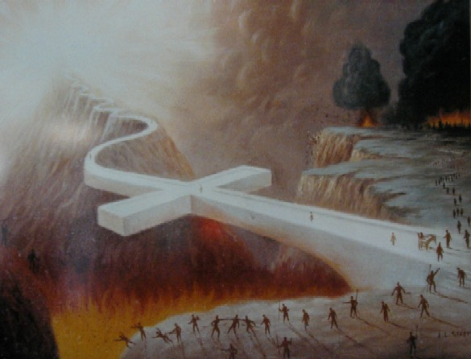
John 14:6 ESV
"I am the way, and the truth, and the life. No one comes to the Father except through me."
Notes:
Verse 6 is one of the most exclusive claims Christ ever made. Is there really only one way to God—and he is that way?

Slide 42
Dr. Steve McSwain
“Therefore, I now know that when Jesus said, 'I am the way, the truth...no one comes to the Father but by me,' he was not saying, as Christian history has mistakenly thought, 'There is no other way to God but by me.' He was simply saying instead, 'The way I live is the way to know God--it's also the way to live happily in this world. If you want to know God, follow my way...emulate how I live, how I think, the way I treat myself, others, and the world.'"
http://www.selfgrowth.com/articles/is-jesus-the-only-way-to-god
Notes:
Many people have a problem with this statement, thinking it sounds arrogant. One such example is the former pastor but now Buddhist, Dr. Steve McSwain. His website is, of course, SelfGrowth.com, where he writes…

Slide 43
Dr. Steve McSwain
“Therefore, I now know that when Jesus said, 'I am the way, the truth...no one comes to the Father but by me,' he was not saying, as Christian history has mistakenly thought, 'There is no other way to God but by me.' He was simply saying instead, 'The way I live is the way to know God—it's also the way to live happily in this world. If you want to know God, follow my way...emulate how I live, how I think, the way I treat myself, others, and the world.'"
http://www.selfgrowth.com/articles/is-jesus-the-only-way-to-god
Notes:
So we need only to do good works? No, Jesus was clear and other texts teach the same…

Slide 44
Other texts say the same...
"Nor is there salvation in any other, for there is no other name under heaven given among men by which we must be saved" (Acts 4:12).
"He who does not believe the Son shall not see life, but the wrath of God abides on him" (John 3:36).
Notes:
The apostle Peter proclaimed to a hostile audience, "Nor is there salvation in any other, for there is no other name under heaven given among men by which we must be saved" (Acts 4:12).
The apostle John wrote, "He who does not believe the Son shall not see life, but the wrath of God abides on him" (John 3:36).

Slide 45
Other texts say the same...
"For there is one God and one Mediator between God and men, the Man Christ Jesus" (1 Timothy 2:5).
"And this is the testimony: that God has given us eternal life, and this life is in His Son. He who has the Son has life; he who does not have the Son of God does not have life" (1 John 5:11-12)
Notes:
Again and again, Scripture stresses that Jesus Christ is the only hope of salvation for the world.
• Only Christ can atone for sin, and therefore only Christ can provide salvation.

Slide 46
Is there really only one way?
Islam
Christianity
Hinduism
Notes:
Many people today reject this idea of Christ being the only way.
Some compare it to different paths to scale the same mountain to God.

Slide 47
Is there really only one way?
Notes:
Dr. Patrick Swift wrote such a book called One Mountain, Many Paths.

Slide 48
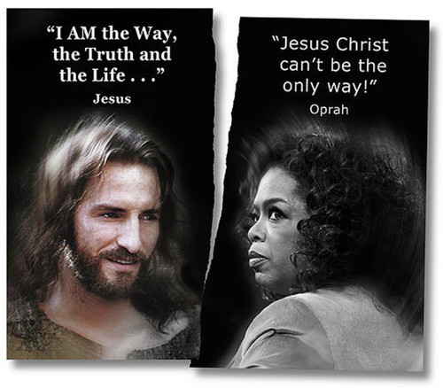
"I AM the Way, the Truth and the Life…"
"Jesus Christ can't be the only way!"
Jesus
Oprah
Notes:
Oprah defiantly declared, “Jesus Christ can’t be the only way!”

Slide 49
Street Cancer Sinking ship
Notes:
Interesting, isn’t it—people have huge problems with Christ claiming to be the only way to God yet accept a single solution to serious problems in other dimensions—like a one way street.
If you have cancer and a doctor claims that a certain type of chemotherapy is the only true way to save your life, he is not deemed arrogant, is he?
If you were in a sinking ship and there was only way out, would you argue, “Hey, that’s being a bit exclusive, isn’t it? Who says your way is the right way, you narrow-minded idiot?”

Slide 50
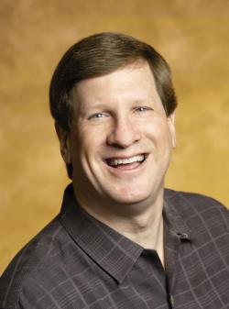
Lee Strobel
JesusChristOnly.com
Notes:
Lee Strobel addresses three myths about religions today. He writes at his website www.JesusChristOnly.com, "The third myth is the one that says:
Christians are narrow-minded or snobbish when they say Jesus is the only way to heaven.
Now, I’d agree Christians would be acting in a narrow-minded way if there really were lots of paths to God and they were saying that theirs is the best way. But they’re not saying that.
They’re saying that the truth of the matter is that someone has got to pay the penalty for our obvious wrongdoing that keeps us away from God. And Jesus, by virtue of His sinlessness and divinity, is the only one qualified to be our substitute. That’s just the reality of the situation. And it’s not narrow-minded to act upon the evidence and pursue truth.
Let me draw you an analogy. I have some friends whose baby girl developed jaundice shortly after birth. Jaundice is a liver disorder that caused her skin and the whites of her eyes to turn yellow. The pediatrician told them that this is a potentially devastating disease but it’s easily treated. All they had to do was put the baby under a special light for a while and this would stimulate her liver properly and she’d be all right.
Now, the parents could have said, “That sounds too easy. How about instead if we scrubbed her with soap and dipped her in bleach? If we worked hard enough, I’m sure we could get her normal coloring back.” But the doctor would have said, “No, there’s only one way to handle this.”
They could have replied, “Well, how about if we just sort of ignore this and pretend everything’s OK? You know — the jaundice is your truth, Doc, not our truth. And if we sincerely believe that, things will work out for the best.” The doctor would have said, “You’d jeopardize your baby if you did that. Look, there’s only one way to cure her. You’re hesitant because it sounds too easy, but look at the credentials hanging on my wall. I’ve studied at medical school and I’ve used what I’ve learned to cure countless babies like yours. Trust me!”
Now, would anybody accuse those parents of being narrow-minded if they trusted that doctor and pursued the only course of treatment that was going to cure their little girl? That’s not narrow-minded; that’s acting rationally in accordance with the evidence.
Well, we all have a terminal illness called sin, and the reason we cling to Christ is because He’s the Great Physician who has the only cure. We can try to scrub away our sin with good deeds, but it won’t work. We can ignore it and hope it goes away, but it won’t. We can sincerely think there’s another way of dealing with it, but we’d be sincerely wrong. The truth is that only the Great Physician offers a treatment that will erase our stain of sin. When we turn to Him, we’re not being narrow-minded; we’re acting rationally in accordance with the evidence.”
_________
http://www.jesuschristonly.com/sermons/lee-strobel/jesus-the-only-way-to-god.html

Slide 51
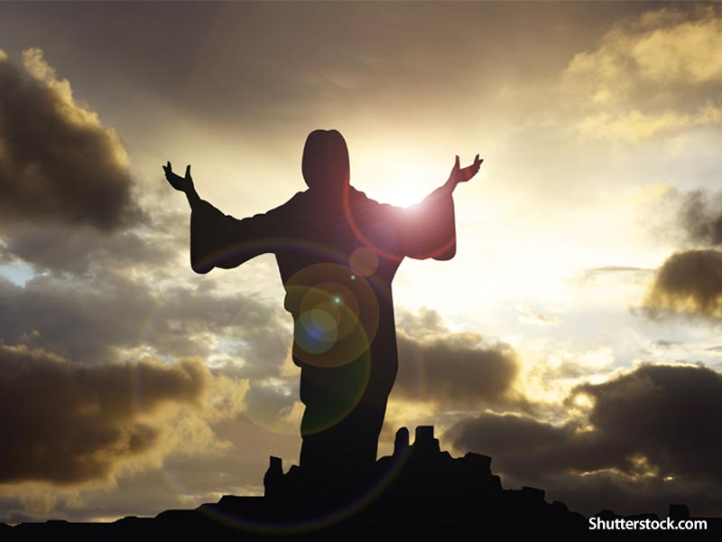
To know Christ is actually to know the Father (14:8-14)

Slide 52
The ONE Way
Lost
Deceived
Dead
Notes:
We come to know the Father though Jesus addressing our three key problems: We are lost, so he is the Way; we are deceived, so he is the Truth, and we are spiritually dead, but he is the Life.
Isn’t it interesting how many people don’t seem to have a problem with “God,” but when we talk of Jesus, we are met with silence—or indifference—or sometimes it is outright resistance. Truly, the name of Jesus is a showstopper!
But Jesus clarified that Jesus and the Father (or God) go together. You can’t separate the two. To know Christ is actually to know the Father.

Slide 53
Confusion
Comfort

Slide 54
Trust Jesus to return as the only way to heaven (Main Idea).

Slide 55
MPI
John 14:1-14: Jesus shows how to gain comfort
Trust Jesus to return for you (14:1-4).
Notes:
You can replace your confusion with Christ’s comfort when you… Believe that Christ will come back to bring you to your heavenly home.

Slide 56
MPII
John 14:1-14: Jesus shows how to gain comfort
Trust Jesus to bring you to God (14:5-14).
Notes:
Believe that Jesus alone can get you to heaven.

Slide 57
Two Country Clubs
Earned Membership
Paid Membership
Notes:
Lee Strobel notes, “It’s not snobbish to believe what Jesus taught about being the way to God. Because, frankly, Christianity is anything but snobbish.
“Let’s pretend there are two country clubs. The first one only admits people who have earned membership. To get in, you’ve got to obtain superior wisdom or fulfill a list of demands and fulfill certain spiritual requirements. Despite their best efforts, lots of people just won’t make the grade and will be excluded. Friends, that’s what other religions are saying by teaching that people have to work their way to God.
“But the second country club says, ‘Anybody who wants in can come in because Jesus has already paid for your membership. Rich or poor, black or white, regardless of your ethnic heritage or where you live, we would love to include you. Entry isn’t based on your qualifications but only on accepting Christ’s invitation. So we’ll leave the matter to you. You decide. But remember, we will never turn you away if you seek admittance.’ That’s what Christianity is like.
“Now, which country club is being snobbish? Christians aren’t putting on airs; we aren’t saying we’re better than anyone else. As one Christian said, ‘We’re just beggars telling other beggars where to find food.’”

Slide 58
What confuses you right now?
Notes:
Here are two key questions for you:
What confuses you right now? Family? Job? Future? Relationships?

Slide 59
Will you accept Christ’s comfort instead?
Notes:
Will you accept Christ’s comfort instead? How?
Trust Jesus to return for you (14:1-4).
Trust Jesus to bring you to God (14:5-14).

Slide 60
Black

Slide 61
NT Preaching link at BibleStudyDownloads.org
Get this presentation and script for free!
Notes:
NT Preaching (np)

